Slide 1
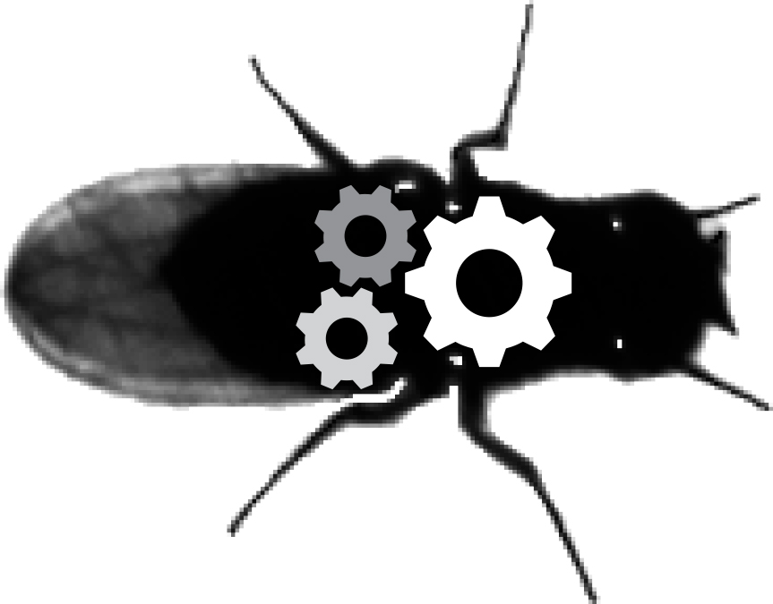
Introduction to decentralized control
Neuroengineering Laboratory

Slide 2

Decentralized or centralized ?
Trafic management system on delay
https://globalhealthnow.org/object/traffic-light

Slide 3
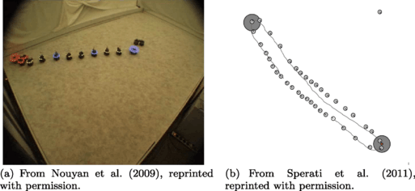
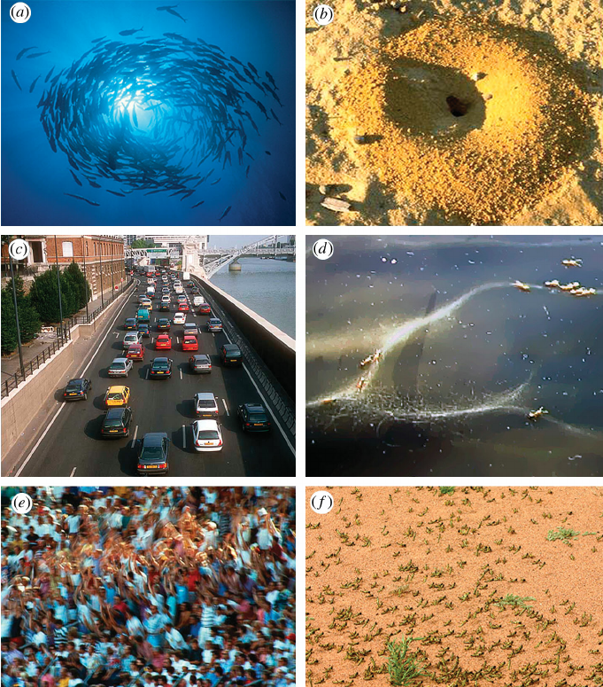
Decentralized or centralized ?
Brambilla et al. Swarm Intelligence (2013)
Sumpter DJT, Philosophical Transactions 2006

Slide 4
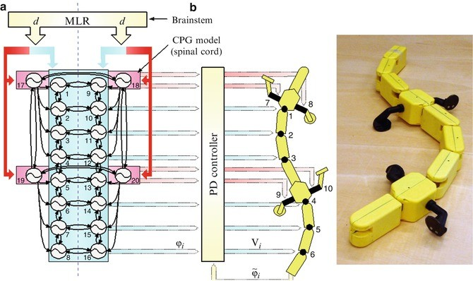
Decentralized or centralized ?
Ijspeert et al. Science (2007)
Notes:
global influences outweigh local influences

Slide 5
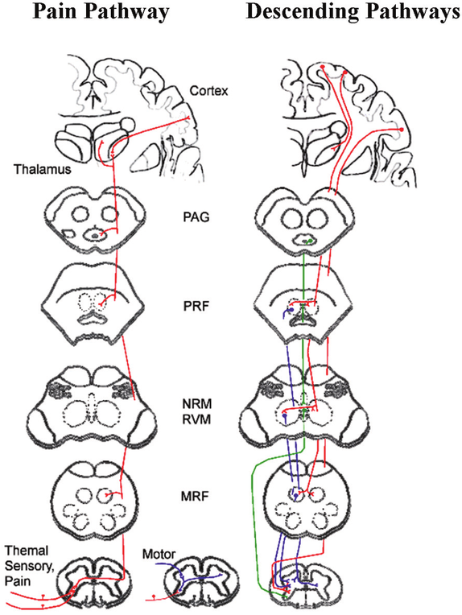
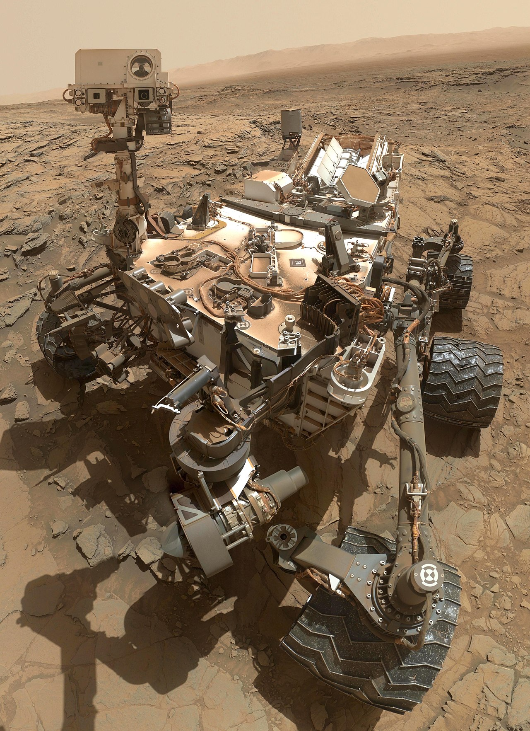
Decentralized or centralized ?
NASA - http://photojournal.jpl.nasa.gov/catalog/PIA19920
Ghazni et al. American Journal of Neuroradiology (2009)

Slide 6
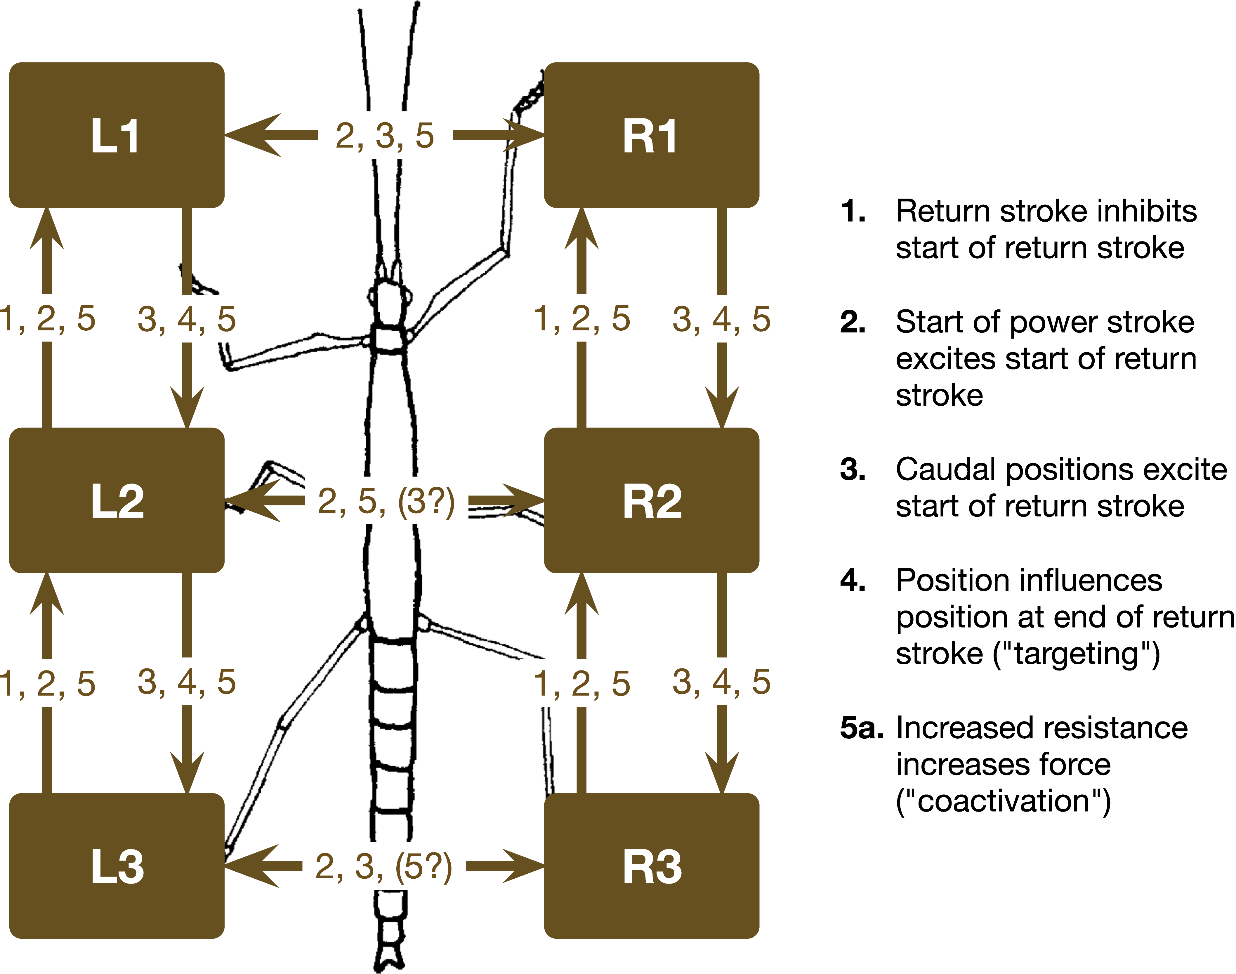
Decentralized or centralized ?
M. Schiling et al. PLOS computational biology (2020)

Slide 7
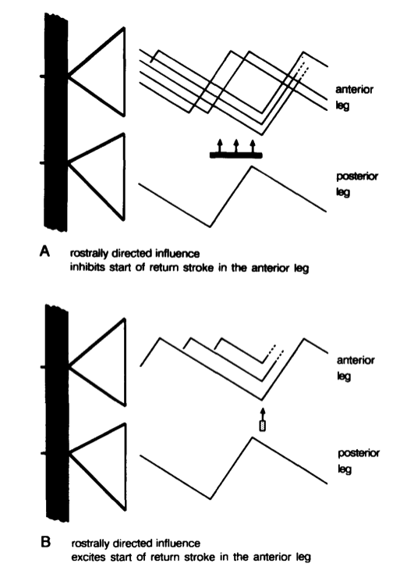
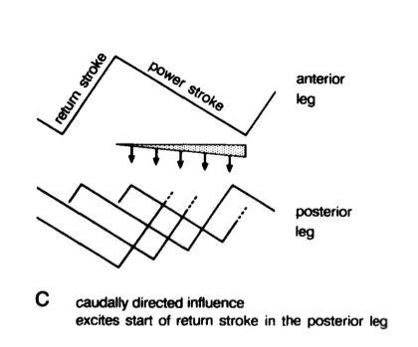
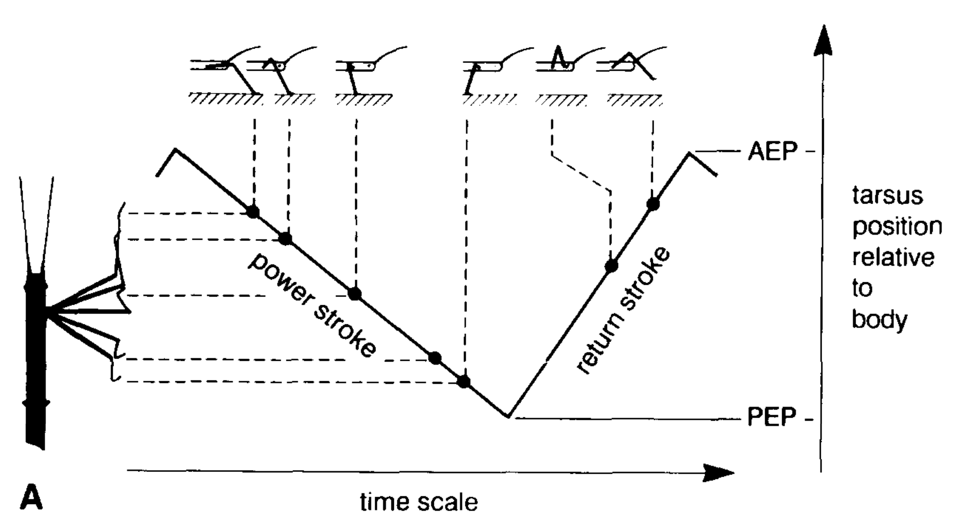
Cruse et al. observations on arthropod locomotion
H.Cruse et al Trends in Neuroscience 1990

Slide 8
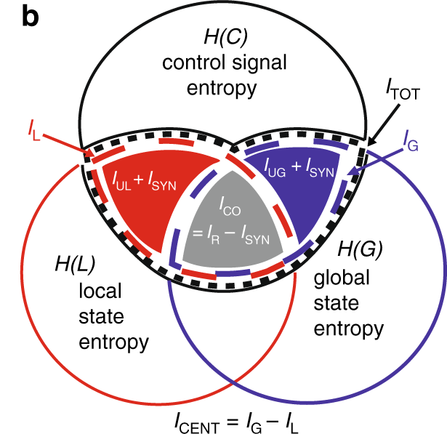
Centralization from an information theory point of view
I_{UL} unique local mutual information
I_{UG} unique global mutual information
I_{SYN} synergist mutual information
I_{R} redondant mutual information
I_{CENT} = I_{G} – I_{L} = I_{UG} – I_{UL}
I.D. Neveln et al. Nature Communications (2019)

Slide 9
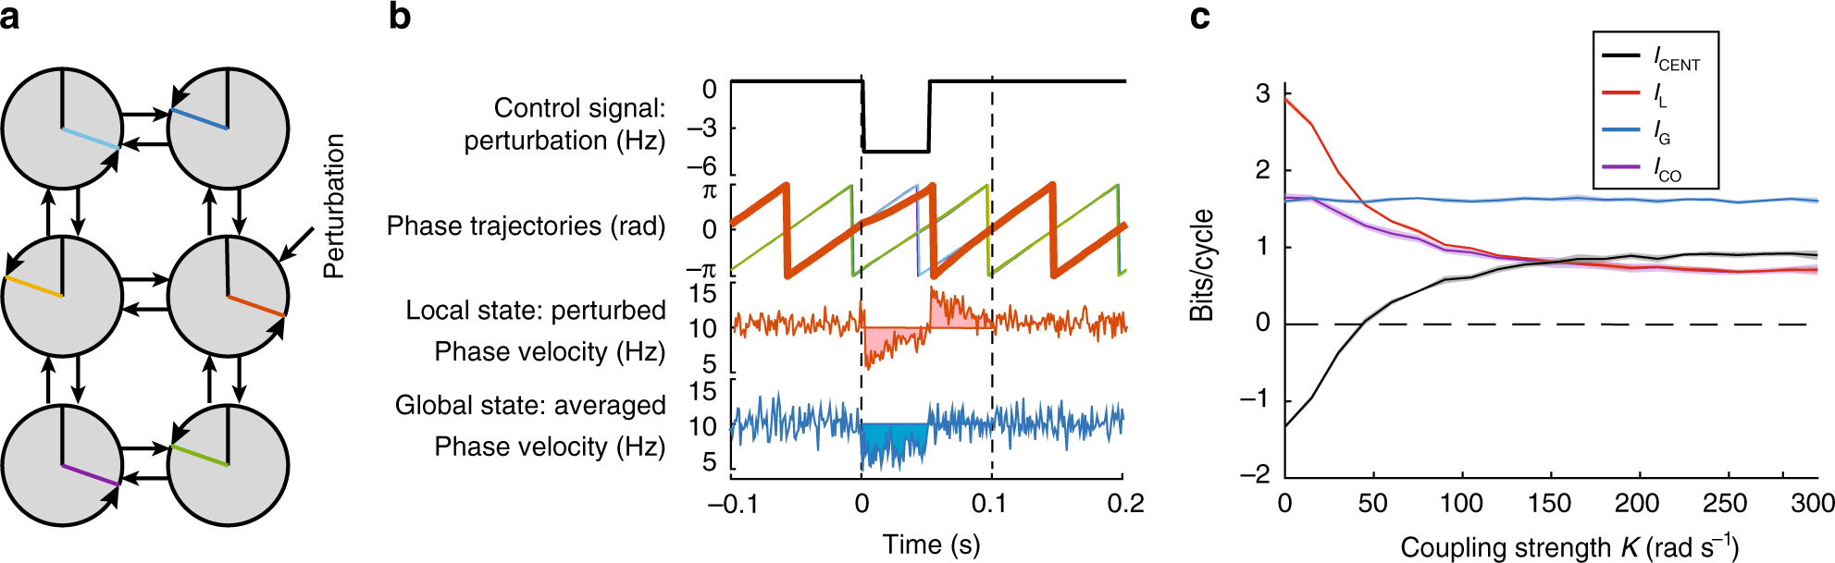
Centralization in a network of coupled oscilators:
I.D. Neveln et al. Nature Communications (2019)

Slide 10
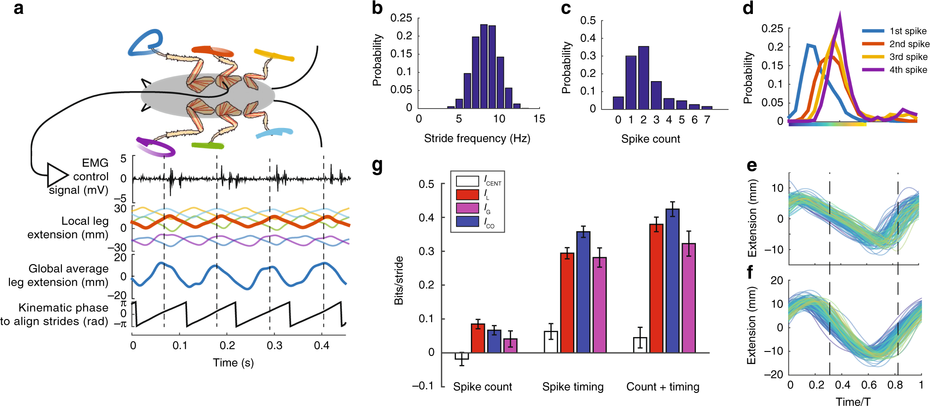
Centralization in cockroach locomotion:
I.D. Neveln et al. Nature Communications (2019)

Slide 11
Centralized decentralized comparison
Centralized:
Fast
Simpler
Decentralized:
Robustness/Redundancy
Adaptability/Flexibility
Modularity

Slide 12
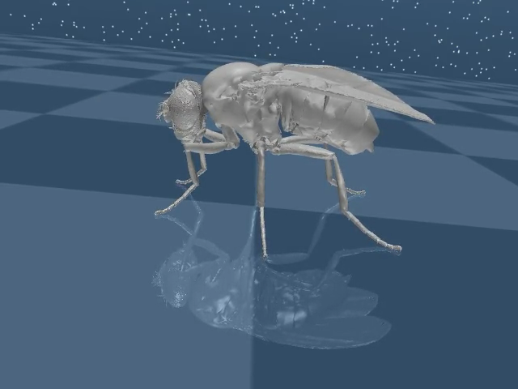
Todays tutorial: Principle
t=0
timesteps
Leg joints
joints

Slide 13
Todays tutorial: Principle
t=1
timesteps
Leg joints
joints

Slide 14
Todays tutorial: Principle
t=N
timesteps
Leg joints
joints

Slide 15
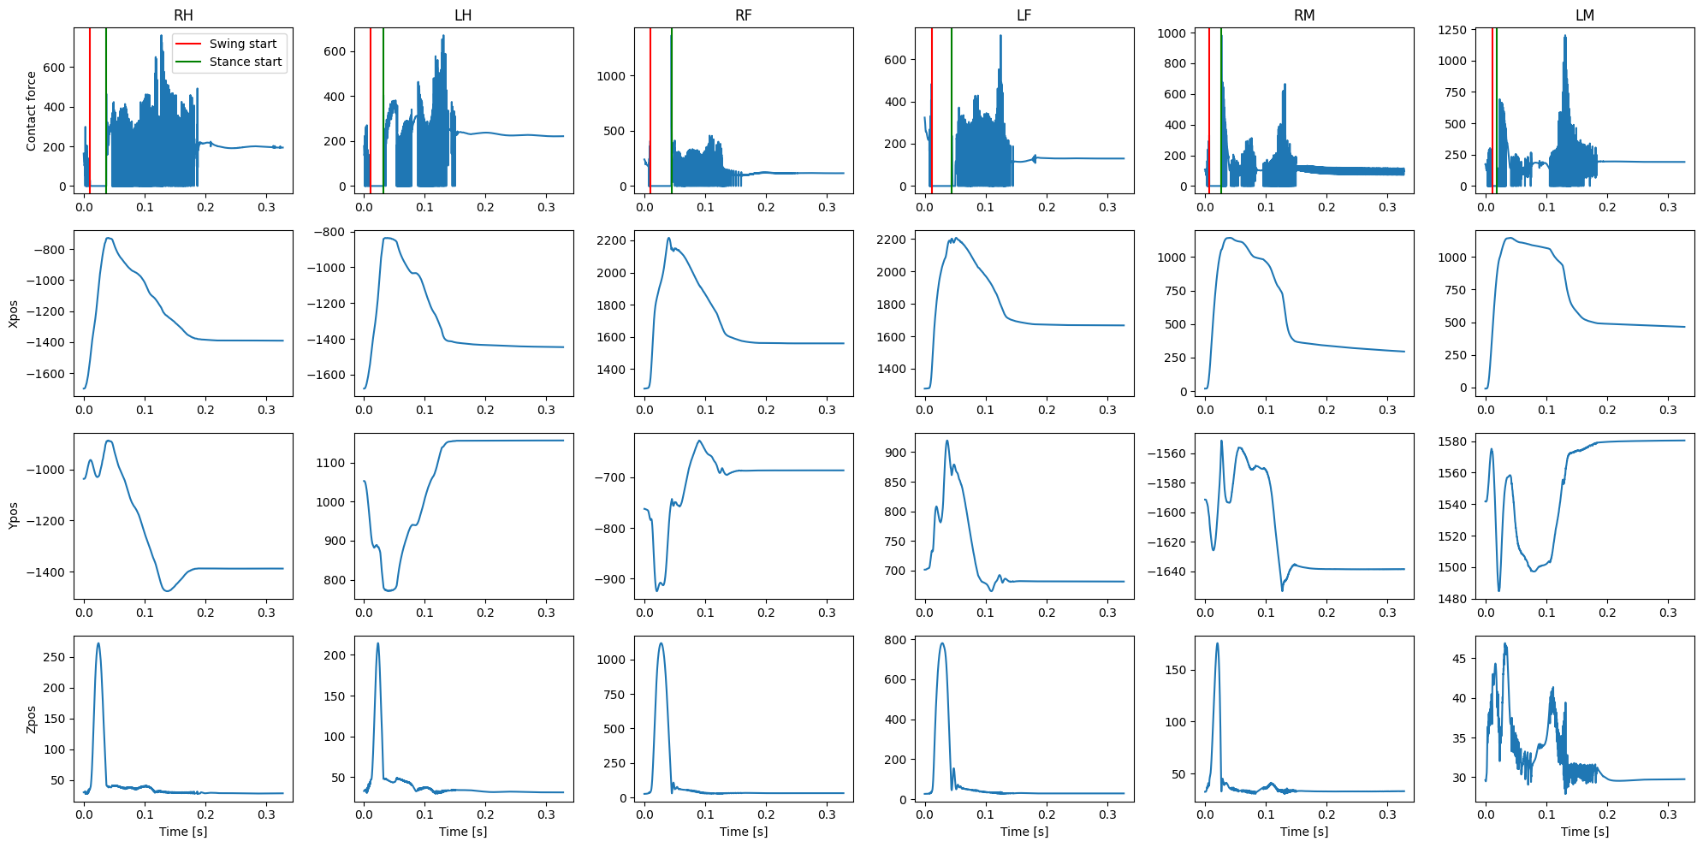
Todays tutorial: Principle
t=0
timesteps
joints
SWING INDEXES
M. Schiling et al. PLOS computational biology (2020)

